Slide 1
Artificial Intelligence

Slide 2
ToPIC’S FOR TODAY
1. Why is AI important to you?
2. Where are we using AI right now?
3. How does the brain work?
4. What are the goals of Artificial Intelligence?
5. What is Intelligence?
6. What are important components of AI systems?
7. What is Intelligent Behavior?
8. What are the Major Branches of AI?
9. The Future

Slide 3
Why do we need to know about AI?
AI will create 500,000 jobs
Demand for skilled workforce
Global competition is fierce
Half of jobs today can be automated
Heed the warning signs, take initiative, and equip yourselves with the skills needed to survive a potentially tumultuous economic evolution.
Notes:
Daniel Marlin , CONTRIBUTORI write about how Millennials can thrive in a modern 500workplace. Opinions expressed by Forbes Contributors are their own.
TWEET THIS
AI will create 500,000 more jobs than it will displace over the next three years
Millennials are the most vulnerable generation to the threats AI poses
Many of the jobs that Millennials work in today didn’t exist when their parents entered the job market. And chances are the young professionals of the future will work in fields that don’t exist today.
Such is the nature of an economy continuously influenced by new technology, and Artificial Intelligence (AI) promises to transform the workplace once again.
Image courtesy of Shutterstock
But while some herald in the AI revolution with unbridled enthusiasm, excited by the opportunities and enriching work it could create, others are more pessimistic. However, both parties agree that AI has widespread application, from automating routine tasks to making complex decisions instantly. The debate is not so much about the power of the technology itself – all agree it’s revolutionary - but rather the role of the people that will work alongside it.
Either way, experts all agree that the workplace is about to change forever. Here are two ways that AI will change careers for young professionals.
Optimists say AI will create more jobs
A study of 1,000 companies revealed that AI systems created new jobs in 80% of the organizations they were implemented in. In fact, a 2017 Gartner report predicts that AI will create 500,000 more jobs than it will displace over the next three years, ushering a slew of employment opportunities for medium-to high-skilled workers.
As the global economy gears up for the widespread adoption of AI solutions, competition grows fierce for employees with the scarce skills required to implement, manage and work alongside this new technology. Developing these skills is therefore vital for any young professional wishing to remain relevant in an increasingly automated workplace.
And as this skilled workforce drives the AI industry forward at an accelerated pace, the demand for even more highly trained professionals will grow alongside it. This will result in a workplace comprising of adaptable people - according to Gartner - whose jobs are reimagined, enriched or facilitated by the technology they work alongside.
While it’s true that many low-skill jobs will fall by the wayside, replaced by the sophisticated automation AI enables, new careers and industries will emerge that haven’t been invented yet. Just as our parents struggled to predict the emergence of fields like social media or blogging, so, too, are we incapable of comprehending the jobs AI will create.

Slide 4
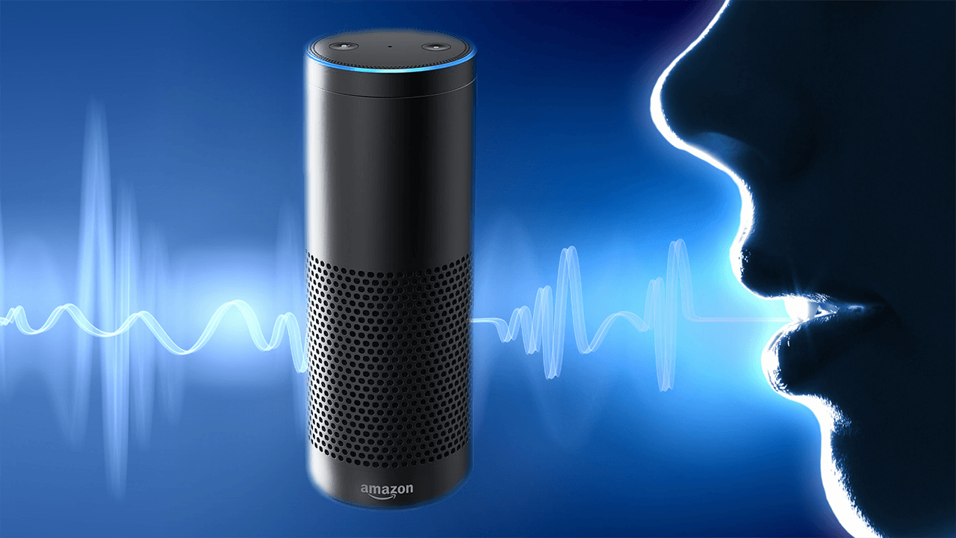
Applications in use today
#1 -- Siri
Everyone is familiar with Apple's personal assistant, Siri. She's the friendly voice-activated computer that we interact with on a daily basis.
#2 -- Alexa
Alexa can help us scour the web for information, shop, schedule appointments, set alarms and a million other things, but also help power our smart homes and be a conduit for those that might have limited mobility.
Notes:
Beyond our quantum-computing conundrum, today's so-called A.I. systems are merely advanced machine learning software with extensive behavioral algorithms that adapt themselves to our likes and dislikes. While extremely useful, these machines aren't getting smarter in the existential sense, but they are improving their skills and usefulness based on a large dataset. These are some of the most popular examples of artificial intelligence that's being used today.
#1 -- Siri
Everyone is familiar with Apple's personal assistant, Siri. She's the friendly voice-activated computer that we interact with on a daily basis. She helps us find information, gives us directions, add events to our calendars, helps us send messages and so on. Siri is a pseudo-intelligent digital personal assistant. She uses machine-learning technology to get smarter and better able to predict and understand our natural-language questions and requests.
#2 -- Alexa
Alexa's rise to become the smart home's hub, has been somewhat meteoric. When Amazon first introduced Alexa, it took much of the world by storm. However, it's usefulness and its uncanny ability to decipher speech from anywhere in the room has made it a revolutionary product that can help us scour the web for information, shop, schedule appointments, set alarms and a million other things, but also help power our smart homes and be a conduit for those that might have limited mobility.

Slide 5
Amazon.com
Amazon's transactional A.I. is something that's been in existence for quite some time, allowing it to make astronomical amounts of money online.
Notes:
With its algorithms refined more and more with each passing year, the company has gotten acutely smart at predicting just what we're interested in purchasing based on our online behavior. While Amazon plans to ship products to us before we even know we need them, it hasn't quite gotten there yet. But it's most certainly on its horizons. With its algorithms refined more and more with each passing year, the company has gotten acutely smart at predicting just what we're interested in purchasing based on our online behavior.

Slide 6
Netflix
Netflix provides highly accurate predictive technology.
Notes:
based on customer's reactions to films. It analyzes billions of records to suggest films that you might like based on your previous reactions and choices of films. This tech is getting smarter and smarter by the year as the dataset grows. However, the tech's only drawback is that most small-labeled movies go unnoticed while big-named movies grow and balloon on the platform.
based on customer's reactions to films. It analyzes billions of records to suggest films that you might like based on your previous reactions and choices of films. This tech is getting smarter and smarter by the year as the dataset grows. However, the tech's only drawback is that most small-labeled movies go unnoticed while big-named movies grow and balloon on the platform.

Slide 7
Pandora
Pandora's A.I. is quite possibly one of the most revolutionary techs that exists out there today. They call it their musical DNA.
GO TO: https://myactivity.google.com
Notes:
Based on 400 musical characteristics, each song is first manually analyzed by a team of professional musicians based on this criteria, and the system has an incredible track record for recommending songs that would otherwise go unnoticed but that people inherently love.
Number Ten: Pandora Is Not All About Music
While most people use the radio service to stream music, in fact, it streams non-music content as well. Users can listen to podcasts and comedy on Pandora.
Number Nine: It’s the Official SXSW Streaming Partner
2016 is the very first year that the company is the official streaming partner of popular film and music festival SXSW. The company will offer a station during the festival that allows users to listen to the festival whether they’re there or not. The station will be called the Pandora Discovery Den at SXSW.
Number Eight: It’s Making Discovering New Music Easier With Browse
The company unveiled a new feature in January 2016 called Browse. Browse allows Pandora users to see stations that are specifically relevant to them and also allows users to interact with the content more profoundly on their iPhones.
Number Seven: It’s Not Global
Because of the company’s ubiquitous presence in the United States, it’s easy to assume it’s available everywhere. However, the truth is that the service is only available in the United States, Australia, and New Zealand.
Number Six: Before It Was Pandora, It Was Savage Beast
Savage Beast Technologies was founded by Tim Westergren, Will Glaser, and Jon Kraft. Glaser developed the Music Genome Project technology that the radio uses today and they changed the company’s name to Pandora in 2004.
Number Five: Everyone Had to Pay in the Beginning
When the radio service launched, users had to pay to use it. However, the company eventually realized it was cutting out a giant chunk of its potential market and implemented advertising so it could provide a free service.
Number Four: It’s Gotten More Than 50 Billion Thumbs Up
As of January 2015, Pandora users had collectively hit the thumbs up button 50 billion times. Impressive!
Number Three: It Used to Have a Podcast
The Pandora Podcast existed from 2006 to 2009 as a way to interview interesting musicians and cover music-related topics. The podcast was hosted by Kevin Seal.
Number Two: It’s Not Affected by the Competition
It’s no secret that there ae a lot of internet radio services that exist today – Beats 1, Spotify, Google, and Rdio, for example, However, Pandora co-founder Tim Westergren revealed that these other services haven’t affected the company’s growth. In fact, the company continues to grow.
Number One: It Didn’t Pay for Marketing in Its First Five Years
According to Westergren, the concept behind Pandora was so exciting when it was first launched that they didn’t need to pay for marketing – people would spread the word themselves. Westergren and his team spent the first five or six years with the company without spending a single cent on marketing. Thanks for reading!
Tags: Pandora, SXSW

Slide 8
What ARE AI SYSTEMS?
Computer systems and machines that demonstrate the characteristics of intelligence are known as Artificial intelligence systems

Slide 9
Artificial intelligence goals
Systems that think like humans.
Systems that think rationally.
Systems that act like humans
Systems that act rationally

Slide 10
Brain VS Computer
The brain uses chemicals to transmit information; the computer uses electricity.
It is much easier and faster for the brain to learn new things. Yet, the computer can do many complex tasks at the same time ("multitasking") that are difficult for the brain.

Slide 11
Notes:
Does this say you have to be a rocket scientist to be intelligent? 11 years of college? 4 years of college Is a baby intelligent? Is a dog intelligent? We are not even going to talk about how to measure intelligence but if you ever want a quandary try that : )

Slide 12
Intelligent behavior
Intelligent behavior
Learn from experience
Apply knowledge acquired from experience
Handle complex situations
Solve problems when important information is missing Slide 21
Determine what is important Counting Exercise
React quickly and correctly to a new situation https://www.youtube.com/watch?v=qcEikk6YK1Y
Understand visual images Slide 18
Process and manipulate symbols
Be creative and imaginative
Use heuristics

Slide 13
TYPES OF LEARNING Constructivism is a philosophy of learning founded on the premise that, by reflecting on our experiences, we construct our own understanding of the world we live in. Each of us generates our own "rules" and "mental models," which we use to make sense of our experiences. Learning, therefore, is simply the process of adjusting our mental models to accommodate new experiences.
The guiding principles of Constructivism:
Learning is a search for meaning. Therefore, learning must start with the issues around which students are actively trying to construct meaning.
Meaning requires understanding wholes as well as parts. And parts must be understood in the context of wholes. Therefore, the learning process focuses on primary concepts, not isolated facts.
In order to teach well, we must understand the mental models that students use to perceive the world and the assumptions they make to support those models.
The purpose of learning is for an individual to construct his or her own meaning, not just memorize the "right" answers and regurgitate someone else's meaning. Since education is inherently interdisciplinary, the only valuable way to measure learning is to make assessment part of the learning process, ensuring it provides students with information on the quality of their learning.

Slide 14
Right Brain vs. Left Brain Definition This theory of the structure and functions of the mind suggests that the two different sides of the brain control two different “modes” of thinking. It also suggests that each of us prefers one mode over the other. Discussion Experimentation has shown that the two different sides, or hemispheres, of the brain are responsible for different manners of thinking. The following table illustrates the differences between left-brain and right-brain thinking:

Slide 15
Right Brain or left?
https://www.youtube.com/watch?v=MVdjupsToAE

Slide 16
The branch of computer science concerned with making computers
behave like humans. The term was coined in 1956 by John McCarthy
at the Massachusetts Institute of Technology. Artificial intelligence
includes
games playing: programming computers to play games such as chess and checkers
expert systems : programming computers to make decisions in real-life situations (for example, some expert systems help doctors diagnose diseases based on symptoms)
natural language : programming computers to understand natural human languages
neural networks : Systems that simulate intelligence by attempting to reproduce the types of physical connections that occur in animal brains
robotics : programming computers to see and hear and react to other sensory stimuli
Currently, no computers exhibit full artificial intelligence (that is, are
able to simulate human behavior). The greatest advances have
occurred in the field of games playing. The best computer chess
programs are now capable of beating humans. In May, 1997, an IBM
super-computer called Deep Blue defeated world chess champion

Slide 17
TYPES OF SYSTEMS
Perceptive system
A system that approximates the way a human sees, hears, and feels objects
Vision system
Capture, store, and manipulate visual images and pictures
Robotics
Mechanical and computer devices that perform tedious tasks with high precision
Expert system
Stores knowledge and makes inferences

Slide 18
Major Branches of AI
Learning system
Computer changes how it functions or reacts to situations based on feedback
Slide 19
Natural language processing
Computers understand and react to statements and commands made in a “natural” language, such as English http://psych.fullerton.edu/mbirnbaum/psych101/Eliza.htm
Neural network
Computer system that can act like or simulate the functioning of the human brain
https://quickdraw.withgoogle.com/

Slide 19
Languages
There are several programming languages that are known as AI
languages because they are used almost exclusively for AI
applications. The two most common are LISP and Prolog.
Natural-language processing offers the greatest potential rewards
because it would allow people to interact with computers without
needing any specialized knowledge. Unfortunately, programming computers to understand natural languages has proved to be more difficult than originally thought. Some rudimentary translation systems that translate from one human language to another are in existence, but they are not nearly as good as human translators. There are also voice recognition systems that can convert spoken sounds into written words, but they do not understand what they are writing;
they simply take dictation. Even these systems are quite limited --
you must speak slowly and distinctly.

Slide 20
Currently, no computers exhibit full artificial intelligence (that is, are able to simulate human behavior). The greatest advances have
occurred in the field of games playing. The best computer chess
programs are now capable of beating humans. In May, 1997, an IBM super-computer called Deep Blue defeated world chess champion Gary Kasparov in a chess match.

Slide 21
Feel Your BRAIN WORK
Say the color of the word
http://faculty.washington.edu/chudler/java/ready.html
Notes:
Turn foot and fingers

Slide 22
When you see the next slide, point immediately in the direction that you see the arrows pointing.

Slide 24
https://www.phdproject.org/

Slide 25
BACK

Slide 26
https://www.youtube.com/watch?v=QaoDXYYtgK0 Facebook AI stopped

Slide 27
Counting Exercise
https://www.youtube.com/watch?v=IGQmdoK_ZfY

Slide 28
Watch closely!!
https://i.kinja-img.com/gawker-media/image/upload/s--d1_TfIT2--/c_fit,fl_progressive,q_80,w_636/18dn0idlxdiujgif.mp4

Slide 29
back

