Slide 1
Artificial Intelligence

Slide 2
ToPIC’S FOR TODAY
1. Why is AI important to you?
2. Where are we using AI right now?
3. How does the brain work?
4. What are the goals of Artificial Intelligence?
5. What is Intelligence?
6. What are important components of AI systems?
7. What is Intelligent Behavior?
8. What are the Major Branches of AI?
9. The Future

Slide 3
Prof Stephen Hawking Warns, Robots Could Evolve Faster Than Human Race and Could Be Hard to Stop
New Law Students At Risk of Losing Law Firm Jobs to AI
Artificial Intelligence Learns And Recreates Complex, Nobel-Winning Physics Experiment
AI Uses Swarm Intelligence To Correctly Predict Winners Of Kentucky Derby
Let Artificial Intelligence Find That Perfect Match For You
Microsoft Develops Artist-Bot That Converts Texts to Images
Japanese AI Writes Short Story, Makes It To Finals Of Literary Competition
How Long Do I Have Left?’ AI Can Help Answer That Question

Slide 4
Why do we need to know about AI?
AI will create 500,000 jobs
Competition is fierce globally for the necessary skills
Demand for skilled workforce
Half of jobs today can be automated
Heed the warning signs, take initiative, and equip yourselves with the skills needed to survive a potentially tumultuous economic evolution.
Notes:
Daniel Marlin , CONTRIBUTORI write about how Millennials can thrive in a modern 500workplace. Opinions expressed by Forbes Contributors are their own.
TWEET THIS
AI will create 500,000 more jobs than it will displace over the next three years
Millennials are the most vulnerable generation to the threats AI poses
Many of the jobs that Millennials work in today didn’t exist when their parents entered the job market. And chances are the young professionals of the future will work in fields that don’t exist today.
Such is the nature of an economy continuously influenced by new technology, and Artificial Intelligence (AI) promises to transform the workplace once again.
Image courtesy of Shutterstock
But while some herald in the AI revolution with unbridled enthusiasm, excited by the opportunities and enriching work it could create, others are more pessimistic. However, both parties agree that AI has widespread application, from automating routine tasks to making complex decisions instantly. The debate is not so much about the power of the technology itself – all agree it’s revolutionary - but rather the role of the people that will work alongside it.
Either way, experts all agree that the workplace is about to change forever. Here are two ways that AI will change careers for young professionals.
Optimists say AI will create more jobs
A study of 1,000 companies revealed that AI systems created new jobs in 80% of the organizations they were implemented in. In fact, a 2017 Gartner report predicts that AI will create 500,000 more jobs than it will displace over the next three years, ushering a slew of employment opportunities for medium-to high-skilled workers.
As the global economy gears up for the widespread adoption of AI solutions, competition grows fierce for employees with the scarce skills required to implement, manage and work alongside this new technology. Developing these skills is therefore vital for any young professional wishing to remain relevant in an increasingly automated workplace.
And as this skilled workforce drives the AI industry forward at an accelerated pace, the demand for even more highly trained professionals will grow alongside it. This will result in a workplace comprising of adaptable people - according to Gartner - whose jobs are reimagined, enriched or facilitated by the technology they work alongside.
While it’s true that many low-skill jobs will fall by the wayside, replaced by the sophisticated automation AI enables, new careers and industries will emerge that haven’t been invented yet. Just as our parents struggled to predict the emergence of fields like social media or blogging, so, too, are we incapable of comprehending the jobs AI will create.

Slide 5
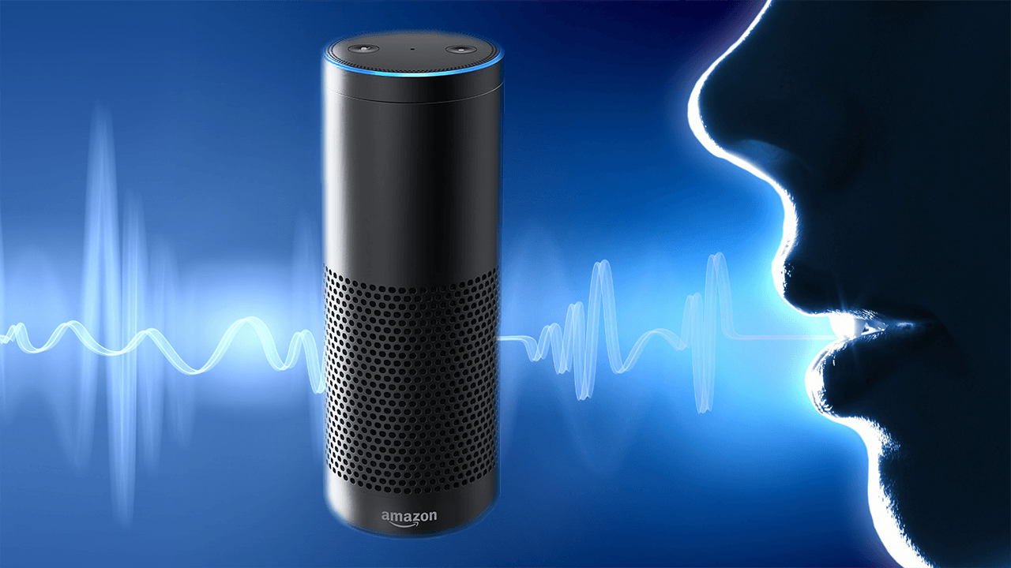
Applications in use today
#1 -- Siri
Everyone is familiar with Apple's personal assistant, Siri. She's the friendly voice-activated computer that we interact with on a daily basis.
#2 -- Alexa
Alexa can help us scour the web for information, shop, schedule appointments, set alarms and a million other things, but also help power our smart homes and be a conduit for those that might have limited mobility.
Notes:
Beyond our quantum-computing conundrum, today's so-called A.I. systems are merely advanced machine learning software with extensive behavioral algorithms that adapt themselves to our likes and dislikes. While extremely useful, these machines aren't getting smarter in the existential sense, but they are improving their skills and usefulness based on a large dataset. These are some of the most popular examples of artificial intelligence that's being used today.
#1 -- Siri
Everyone is familiar with Apple's personal assistant, Siri. She's the friendly voice-activated computer that we interact with on a daily basis. She helps us find information, gives us directions, add events to our calendars, helps us send messages and so on. Siri is a pseudo-intelligent digital personal assistant. She uses machine-learning technology to get smarter and better able to predict and understand our natural-language questions and requests.
#2 -- Alexa
Alexa's rise to become the smart home's hub, has been somewhat meteoric. When Amazon first introduced Alexa, it took much of the world by storm. However, it's usefulness and its uncanny ability to decipher speech from anywhere in the room has made it a revolutionary product that can help us scour the web for information, shop, schedule appointments, set alarms and a million other things, but also help power our smart homes and be a conduit for those that might have limited mobility.

Slide 6

Amazon.com
Amazon's transactional A.I. is something that's been in existence for quite some time, allowing it to make astronomical amounts of money online.
Notes:
With its algorithms refined more and more with each passing year, the company has gotten acutely smart at predicting just what we're interested in purchasing based on our online behavior. While Amazon plans to ship products to us before we even know we need them, it hasn't quite gotten there yet. But it's most certainly on its horizons. With its algorithms refined more and more with each passing year, the company has gotten acutely smart at predicting just what we're interested in purchasing based on our online behavior.

Slide 7

Netflix
Netflix provides highly accurate predictive technology.
Notes:
based on customer's reactions to films. It analyzes billions of records to suggest films that you might like based on your previous reactions and choices of films. This tech is getting smarter and smarter by the year as the dataset grows. However, the tech's only drawback is that most small-labeled movies go unnoticed while big-named movies grow and balloon on the platform.
based on customer's reactions to films. It analyzes billions of records to suggest films that you might like based on your previous reactions and choices of films. This tech is getting smarter and smarter by the year as the dataset grows. However, the tech's only drawback is that most small-labeled movies go unnoticed while big-named movies grow and balloon on the platform.

Slide 8

Pandora
Pandora's A.I. is quite possibly one of the most revolutionary techs that exists out there today. They call it their musical DNA.
GO TO: https://myactivity.google.com
Notes:
Based on 400 musical characteristics, each song is first manually analyzed by a team of professional musicians based on this criteria, and the system has an incredible track record for recommending songs that would otherwise go unnoticed but that people inherently love.
Number Ten: Pandora Is Not All About Music
While most people use the radio service to stream music, in fact, it streams non-music content as well. Users can listen to podcasts and comedy on Pandora.
Number Nine: It’s the Official SXSW Streaming Partner
2016 is the very first year that the company is the official streaming partner of popular film and music festival SXSW. The company will offer a station during the festival that allows users to listen to the festival whether they’re there or not. The station will be called the Pandora Discovery Den at SXSW.
Number Eight: It’s Making Discovering New Music Easier With Browse
The company unveiled a new feature in January 2016 called Browse. Browse allows Pandora users to see stations that are specifically relevant to them and also allows users to interact with the content more profoundly on their iPhones.
Number Seven: It’s Not Global
Because of the company’s ubiquitous presence in the United States, it’s easy to assume it’s available everywhere. However, the truth is that the service is only available in the United States, Australia, and New Zealand.
Number Six: Before It Was Pandora, It Was Savage Beast
Savage Beast Technologies was founded by Tim Westergren, Will Glaser, and Jon Kraft. Glaser developed the Music Genome Project technology that the radio uses today and they changed the company’s name to Pandora in 2004.
Number Five: Everyone Had to Pay in the Beginning
When the radio service launched, users had to pay to use it. However, the company eventually realized it was cutting out a giant chunk of its potential market and implemented advertising so it could provide a free service.
Number Four: It’s Gotten More Than 50 Billion Thumbs Up
As of January 2015, Pandora users had collectively hit the thumbs up button 50 billion times. Impressive!
Number Three: It Used to Have a Podcast
The Pandora Podcast existed from 2006 to 2009 as a way to interview interesting musicians and cover music-related topics. The podcast was hosted by Kevin Seal.
Number Two: It’s Not Affected by the Competition
It’s no secret that there ae a lot of internet radio services that exist today – Beats 1, Spotify, Google, and Rdio, for example, However, Pandora co-founder Tim Westergren revealed that these other services haven’t affected the company’s growth. In fact, the company continues to grow.
Number One: It Didn’t Pay for Marketing in Its First Five Years
According to Westergren, the concept behind Pandora was so exciting when it was first launched that they didn’t need to pay for marketing – people would spread the word themselves. Westergren and his team spent the first five or six years with the company without spending a single cent on marketing. Thanks for reading!
Tags: Pandora, SXSW

Slide 9
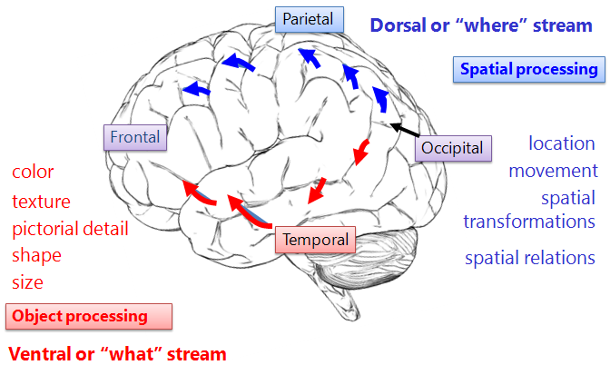
Notes:
Criminals

Slide 10
Feel Your BRAIN WORK
http://faculty.washington.edu/chudler/java/ready.html
http://faculty.washington.edu/chudler/java/ready.html
Notes:
Turn foot and fingers

Slide 11
When you see the next slide, point immediately in the direction that you see the arrows pointing.

Slide 12


Slide 13
Right Brain or left?
https://www.youtube.com/watch?v=MVdjupsToAE

Slide 14
Artificial intelligence goals
Systems that think like humans.
Systems that think rationally.
Systems that act like humans
Systems that act rationally

Slide 15
Vision
Natural Language
Understanding
Robotics
Speech
Expert Systems
Artificial Neural Systems
Expert Systems

Slide 16
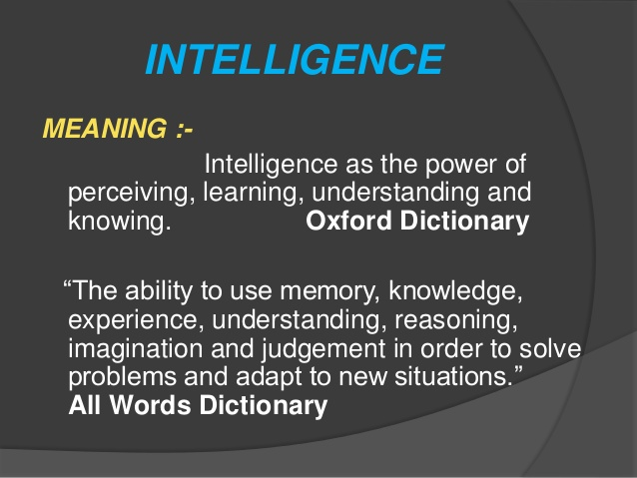
Notes:
Does this say you have to be a rocket scientist to be intelligent? 11 years of college? 4 years of college Is a baby intelligent? Is a dog intelligent? We are not even going to talk about how to measure intelligence but if you ever want a quandary try that : )

Slide 17
Intelligent behavior
Intelligent behavior
  Learn from experience
  Apply knowledge acquired from experience
  Handle complex situations
  Solve problems when important information is missing Slide 21
  Determine what is important Counting Exercise
  React quickly and correctly to a new situation
  Understand visual images Slide 21
  Process and manipulate symbols
  Be creative and imaginative
  Use heuristics

Slide 18
Major Branches of AI
  Learning system
    Computer changes how it functions or reacts to situations based on feedback
    Slide 19
  Natural language processing
    Computers understand and react to statements and commands made in a “natural” language, such as English http://psych.fullerton.edu/mbirnbaum/psych101/Eliza.htm
  Neural network
    Computer system that can act like or simulate the functioning of the human brain
    https://quickdraw.withgoogle.com/

Slide 19

https://www.phdproject.org/

Slide 20
https://www.youtube.com/watch?v=QaoDXYYtgK0 Facebook AI stopped

Slide 21
Counting Exercise
https://www.youtube.com/watch?v=IGQmdoK_ZfY

Slide 22
Watch closely!!
https://i.kinja-img.com/gawker-media/image/upload/s--d1_TfIT2--/c_fit,fl_progressive,q_80,w_636/18dn0idlxdiujgif.mp4

Slide 23
